Slide 1

Lecture 18 Concurrency Control
(Chapter 18)
Prof. Jihong Guan
Email: jhguan@tongji.edu.cn
Department of Computer Science and Technology
Tongji University

Slide 2
Outline of the Course
Part 0: Overview
Ch1: Introduction
Part 1 Relational Databases
Ch2: Relational model (data model, relational algebra)
Ch3&4: SQL(Structured Query Language)
Ch5: Advanced SQL
Part 2 Database Design
Ch6: Database design based on E-R model
Ch7: Relational database design
Part 3 Application Design & Development
Ch8: Complex data types
Ch9: Application development
Part 4 Big data analytics
Ch10: Big data
Ch11: Data analytics
Part 5 Data Storage & Indexing
Ch12: Physical storage system
Ch13: Data storage structure
Ch14: Indexing
Part 6 Query Processing & Optimization
Ch15: Query processing
Ch16: Query optimization
☞ Part 7 Transaction Management
Ch17: Transactions
Ch18: Concurrency control
Ch19: Recovery system
Part 8 Parallel & Distributed Database
Ch20: Database system architecture
Ch21-23: Parallel & distributed storage, query processing & transaction processing
Part 9
DB Platform:OceanBase, MongoDB, Neo4J

Slide 3
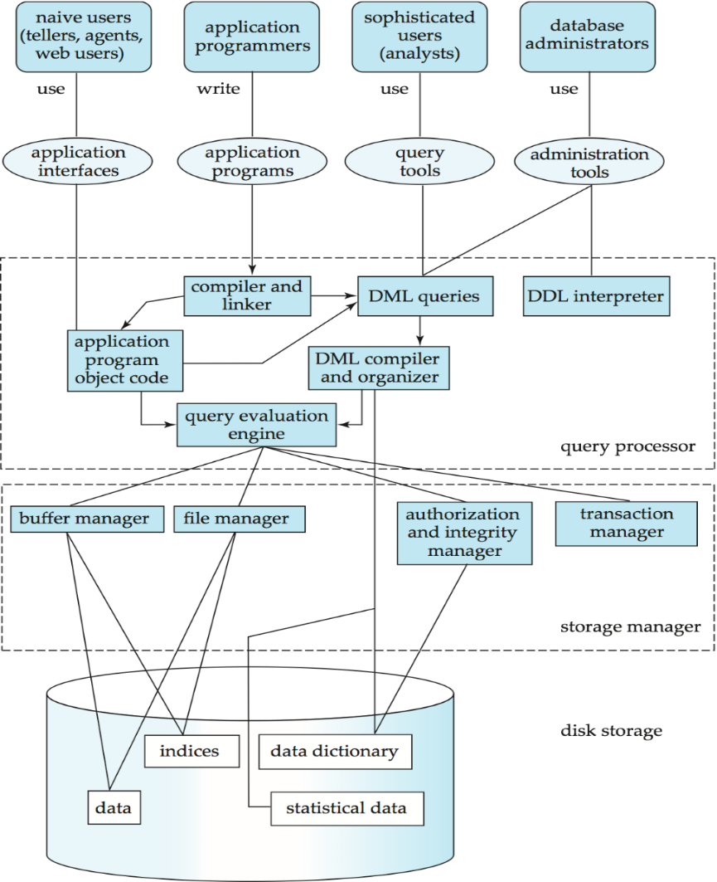
Users
Applications/tools
Database
System
Structure
DBMS
Database

Slide 4
Outline
☞ Concurrent Control
Lock-based Protocols
Graph-based Protocols
Multiple Granularity
Deadlock Handling

Slide 5
Concurrent Control Problems
Problems caused by concurrent transactions
Lost Update (丢失修改 )
Non-repeatable Read (不可重复读 )
Dirty Read (读“脏”数据 )
Symbols
R(x): read x
W(x): write x

Slide 6
Lost Update
T₁ and T₂ read the same data item and modify it
The committed result of T₂ eliminates the update of T₁
T₁ | T₂
① R(A)=16
② | R(A)=16
③ A←A-1
W(A)=15
④ | A←A-1
 | W(A)=15

Slide 7
Non-repeatable Read
T₁ | T₂
① R(A)=50
R(B)=100
sum=150
② | R(B)=100
 | B←B*2
 | W(B)=200
③ R(A)=50
R(B)=200
sum=250
(sum is not correct)
T₁ reads B=100
T₂ reads B, then updates B=200, and writes back B
T₁ reads B again, and B=200, not the same as the first read
Phantom Phenomenon (幻影现象)
records disappear or new records appear for the same query

Slide 8
Dirty Read
T₁ modifies C to 200, T₂ reads C as 200
T₁ rolls back for some reason and its modification also rolls back. Then C recovers to 100
T₂ reads C as 200, which is not consistent with the database
T₁ | T₂
① R(C)=100
C←C*2
W(C)=200
② | R(C)=200
③ ROLLBACK
C recover to 100

Slide 9
Outline
Concurrent Control
☞ Lock-based Protocols
Graph-based Protocols
Multiple Granularity
Deadlock Handling

Slide 10
Lock-based Protocols
A lock is a mechanism to control concurrent access to a data item
Data items can be locked in two modes
exclusive (X) mode (排他型). Data item can be read and written. X-lock is requested using lock-X instruction
shared (S) mode (共享型). Data item can only be read. S-lock is requested using lock-S instruction
Lock requests are made to concurrency control manager (并发控制管理器). Transaction can proceed only after the request is granted.

Slide 11
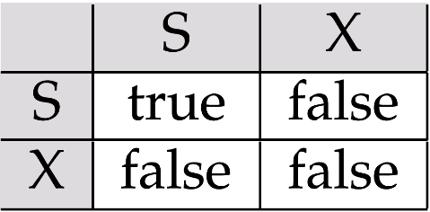
Lock-based Protocols (Cont.)
Lock-compatibility matrix (锁相容性矩阵)
A transaction may be granted a lock on a data item if the requested lock is compatible with locks already held on the data item by other transactions.
If a lock cannot be granted, the requesting transaction waits till all incompatible locks have been released. The lock is then granted.

Slide 12
No Lost Update
T₁ | T₂
① Xlock A
② R(A)=16
 | Xlock A
③ A←A-1 | wait
W(A)=15 | wait
Commit | wait
Unlock A | wait
④ | Get Xlock A
 | R(A)=15
 | A←A-1
⑤ | W(A)=14
 | Commit
 | Unlock A

Slide 13
Repeatable Read
T₁ | T₂
① Slock A
Slock B
R(A)=50
R(B)=100
sum=150
② | Xlock B
 | wait
 | wait
③ R(A)=50 | wait
R(B)=100 | wait
sum=150 | wait
Commit | wait
Unlock A | wait
Unlock B | wait
④ | get XlockB
 | R(B)=100
 | B←B*2
⑤ | W(B)=200
 | Commit
 | Unlock B

Slide 14
No Dirty Read
T₁ | T₂
① Xlock C
R(C)=100
C←C*2
W(C)=200
② | Slock C
 | wait
③ ROLLBACK | wait
(C rec. 100) | wait
Unlock C | wait
④ | Get Slock C
 | R(C)=100
⑤ | Commit C
 | Unlock C

Slide 15
Lock-based Protocols
T: lock-S(A);
read (A);
unlock(A);
lock-S(B);
read (B);
unlock(B);
display(A+B)
Locking as above is not sufficient to guarantee serializability. If A and B get updated in-between the read of A and B, the displayed sum would be wrong
A locking protocol is a set of rules
followed by all transactions while requesting and releasing locks
locking protocols restrict the set of possible schedules

Slide 16
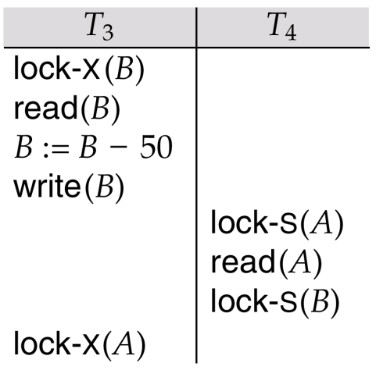
Deadlock (死锁)
Consider the following partial schedule
Such a situation is called a deadlock
To handle the deadlock, T₃ or T₄ must be rolled back and release its locks
Deadlock exists in most locking protocols

Slide 17
Starvation (饥饿)
Starvation
E.g., a transaction may be waiting for an X-lock on a data item, while a sequence of other transactions request and are granted an S-lock on the same data item
The same transaction is repeatedly rolled back due to deadlocks
Concurrency control manager can be designed to prevent starvation

Slide 18
Two-Phase Locking Protocol
2PL is a protocol which ensures conflict-serializable schedules
Phase 1: Growing Phase (增长阶段)
transaction can obtain locks but cannot release locks
Phase 2: Shrinking Phase (缩减阶段）
transaction can release locks but cannot obtain locks
The protocol assures serializability. It can be proved that the transactions can be serialized in the order of their lock points (封锁点)
Lock point: 事务获得最后加锁的位置

Slide 19
The Two-Phase Locking Protocol
Satisfy 2PL
Slock A Slock B Xlock C Unlock B Unlock A Unlock C；
|← Growing →| |← Shrinking →|
Not satisfy 2PL
Slock A Unlock A Slock B Xlock C Unlock C Unlock B；

Slide 20
The Two-Phase Locking Protocol
T₁ | T₂
Slock(A)
R(A=260)
 | Slock(C)
 | R(C=300)
Xlock(A)
W(A=160)
 | Xlock( C )
 | W(C=250)
 | Slock(A)
Slock(B) | wait
R(B=1000) | wait
Xlock(B) | wait
W(B=1100) | Wait
Unlock(A) | wait
 | R(A=160)
 | Xlock(A)
Unlock(B)
 | W(A=210)
 | Unlock( C ) Unlock( A )
2PL ensures serializable schedules

Slide 21
The Two-Phase Locking Protocol
Two-phase locking cannot avoid deadlocks.
Cascading roll-back is possible under two-phase locking
To avoid this, follow a modified protocol called strict two-phase locking (严格两阶段封锁)
A transaction must hold all its exclusive locks till it commits
Rigorous two-phase locking (强两阶段封锁) is even stricter
all locks are held till commit/abort
transactions can be serialized in the order in which they commit

Slide 22
Lock Conversions (锁转换)
Two-phase locking with lock conversions
Upgrade (升级)
lock-S -> lock-X
Downgrade (降级)
lock-X -> lock-S
This protocol assures serializability
T8： read(a₁)
read(a₂)
…
read(a_{n})
write(a₁)
T9: read(a₁)
read(a₂)
display(a₁+a₂)

Slide 23
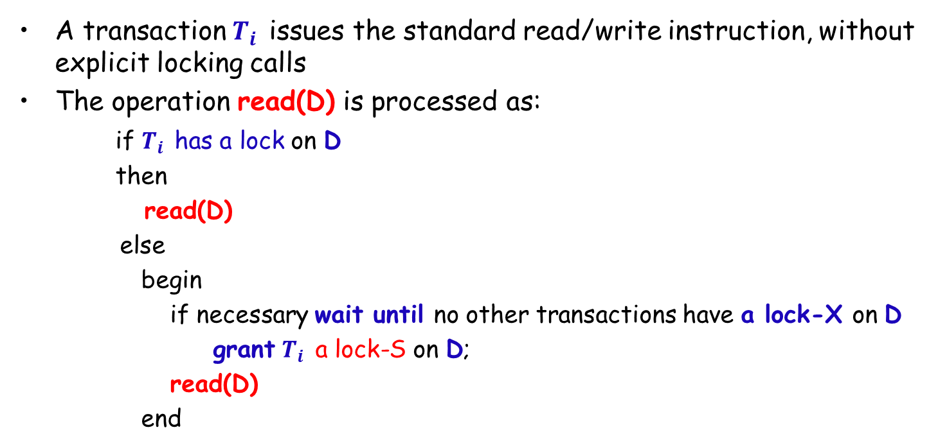
Automatic Acquisition of Locks
A transaction $T_{i}$ issues the standard read/write instruction, without explicit locking calls
The operation read(D) is processed as:
if $T_{i}$ has a lock on D
then
read(D)
else
begin
if necessary wait until no other transactions have a lock-X on D
grant $T_{i}$ a lock-S on D;
read(D)
end

Slide 24
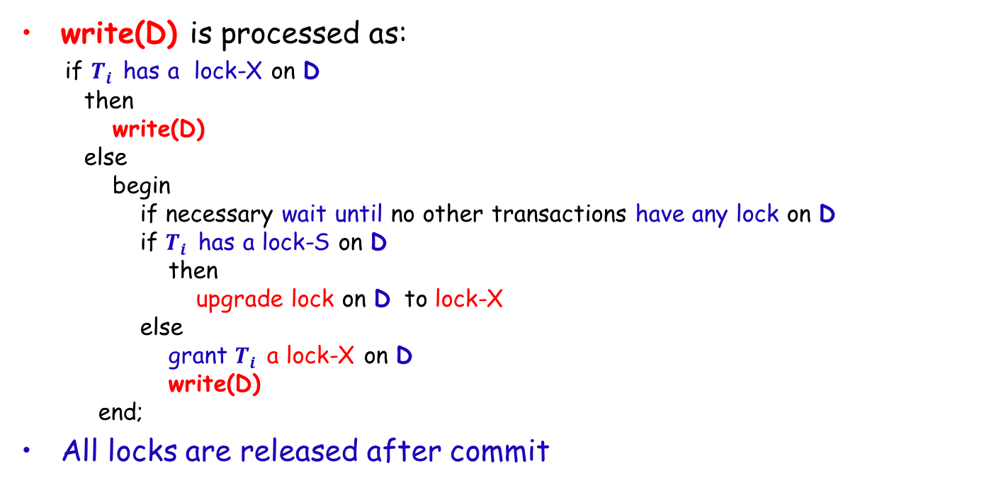
Automatic Acquisition of Locks (Cont.)
write(D) is processed as:
if $T_{i}$ has a lock-X on D
then
write(D)
else
begin
if necessary wait until no other transactions have any lock on D
if $T_{i}$ has a lock-S on D
then
upgrade lock on D to lock-X
else
grant $T_{i}$ a lock-X on D
write(D)
end;
All locks are released after commit

Slide 25
Implementation of Locking
Lock manager (锁管理器)
A lock manager can be implemented as a separate process to which transactions send lock and unlock requests
The lock manager replies to a lock request by sending a lock grant messages (or a message asking the transaction to roll back, in case of a deadlock)
The requesting transaction waits until its request is answered
The lock manager maintains a data-structure called a lock table (锁表) to record granted locks and pending requests
The lock table is usually implemented as an in-memory hash table indexed on the name of the data item being locked

Slide 26
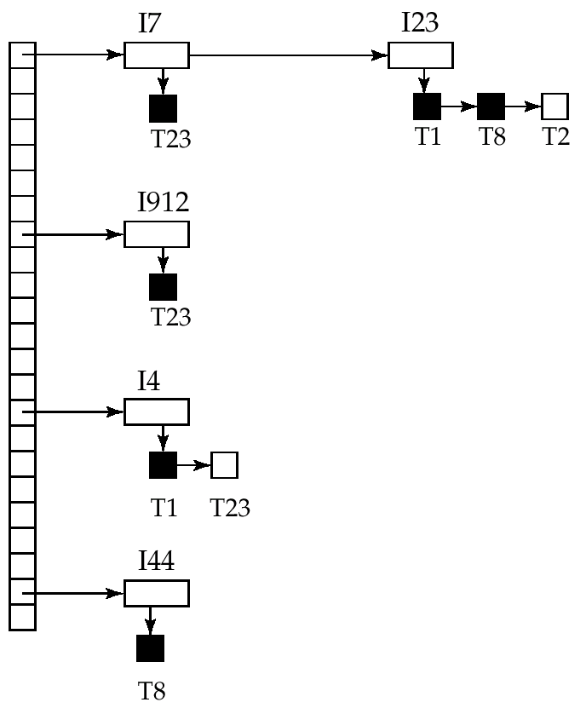
Lock Table
Black rectangles indicate granted locks, and white ones indicate waiting requests
Lock table also records the type of lock granted or requested
New request is added to the end of the queue of requests for the data item, and granted if it is compatible with all earlier locks
Unlock requests result in the request being deleted, and later requests are checked to see if they can now be granted
If transaction aborts, all waiting or granted requests of the transaction are deleted
lock manager may keep a list of locks held by each transaction, to implement this efficiently

Slide 27
Outline
Concurrent Control
Lock-based Protocols
☞ Graph-based Protocols
Multiple Granularity
Deadlock Handling

Slide 28
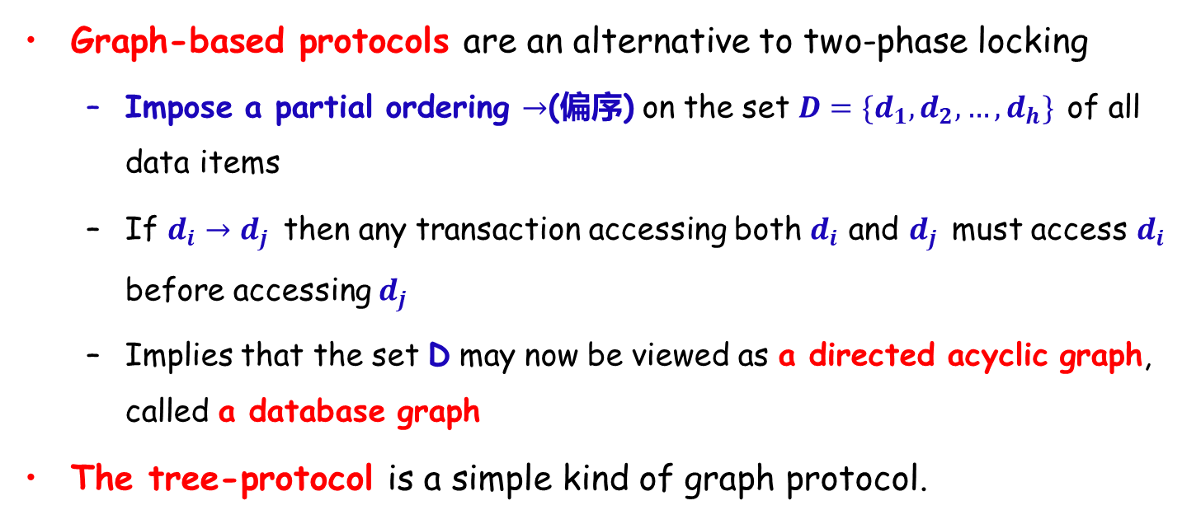
Graph-based Protocols
Graph-based protocols are an alternative to two-phase locking
Impose a partial ordering $→$(偏序) on the set $D=\{d_{1},d_{2},…,d_{h}\}$ of all data items
If $d_{i}→d_{j}$ then any transaction accessing both $d_{i}$ and $d_{j}$ must access $d_{i}$ before accessing $d_{j}$
Implies that the set D may now be viewed as a directed acyclic graph, called a database graph
The tree-protocol is a simple kind of graph protocol.

Slide 29
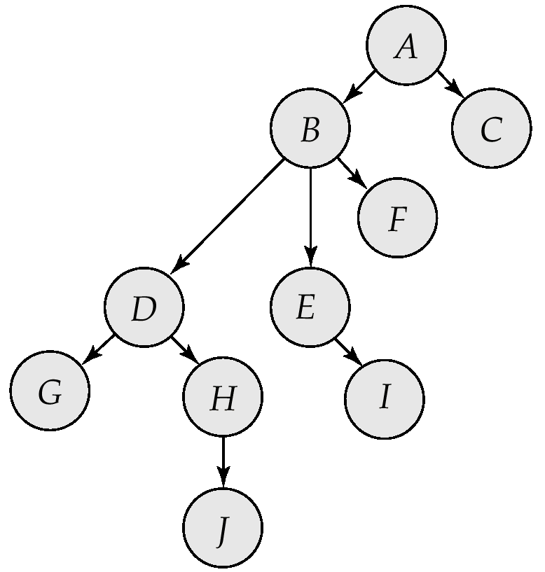
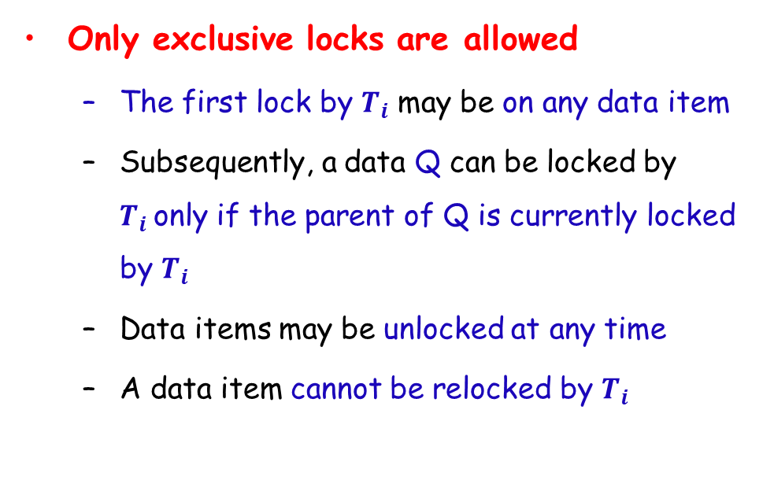
Tree Protocol
Only exclusive locks are allowed
The first lock by $T_{i}$ may be on any data item
Subsequently, a data Q can be locked by $T_{i}$only if the parent of Q is currently locked by $T_{i}$
Data items may be unlocked at any time
A data item cannot be relocked by $T_{i}$

Slide 30
Graph-based Protocols
The tree protocol ensures conflict serializability as well as freedom from deadlock
Unlocking may occur earlier than in the two-phase locking protocol-2PL
shorter waiting times, and increase in concurrency
protocol is deadlock-free, no rollbacks are required
the abort of a transaction can still lead to cascading rollbacks
However, may have to lock data items that it does not access
increased locking overhead, and additional waiting time
potential decrease in concurrency

Slide 31
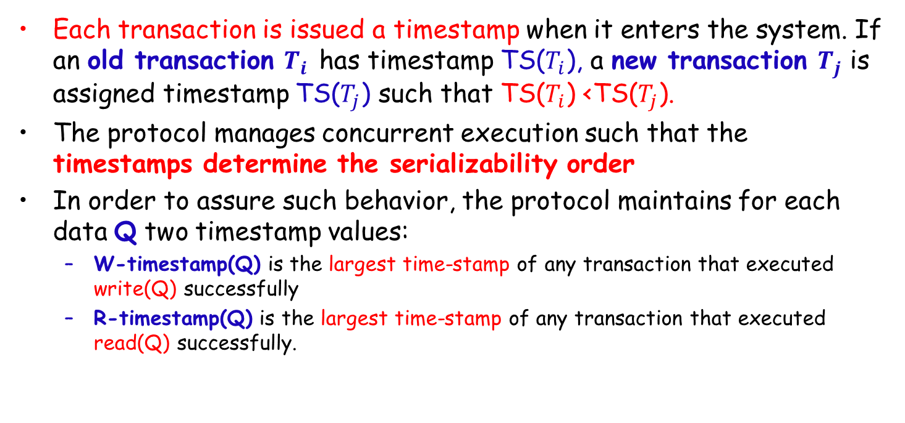
Timestamp-based Protocols
Each transaction is issued a timestamp when it enters the system. If an old transaction $T_{i}$ has timestamp TS($T_{i}$), a new transaction $T_{j}$ is assigned timestamp TS($T_{j}$) such that TS($T_{i}$) <TS($T_{j}$).
The protocol manages concurrent execution such that the timestamps determine the serializability order
In order to assure such behavior, the protocol maintains for each data Q two timestamp values:
W-timestamp(Q) is the largest time-stamp of any transaction that executed write(Q) successfully
R-timestamp(Q) is the largest time-stamp of any transaction that executed read(Q) successfully.

Slide 32
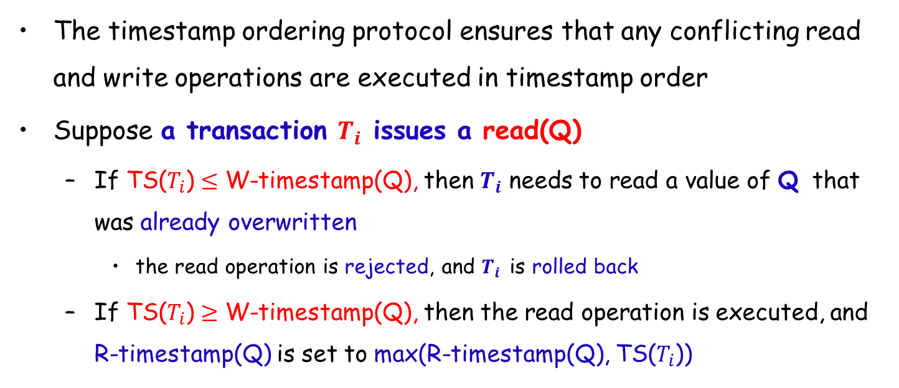
Timestamp-based Protocols (Cont.)
The timestamp ordering protocol ensures that any conflicting read and write operations are executed in timestamp order
Suppose a transaction $T_{i}$ issues a read(Q)
If TS($T_{i}$) $≤$ W-timestamp(Q), then $T_{i}$ needs to read a value of Q that was already overwritten
the read operation is rejected, and $T_{i}$ is rolled back
If TS($T_{i}$) $≥$ W-timestamp(Q), then the read operation is executed, and R-timestamp(Q) is set to max(R-timestamp(Q), TS($T_{i}$))

Slide 33
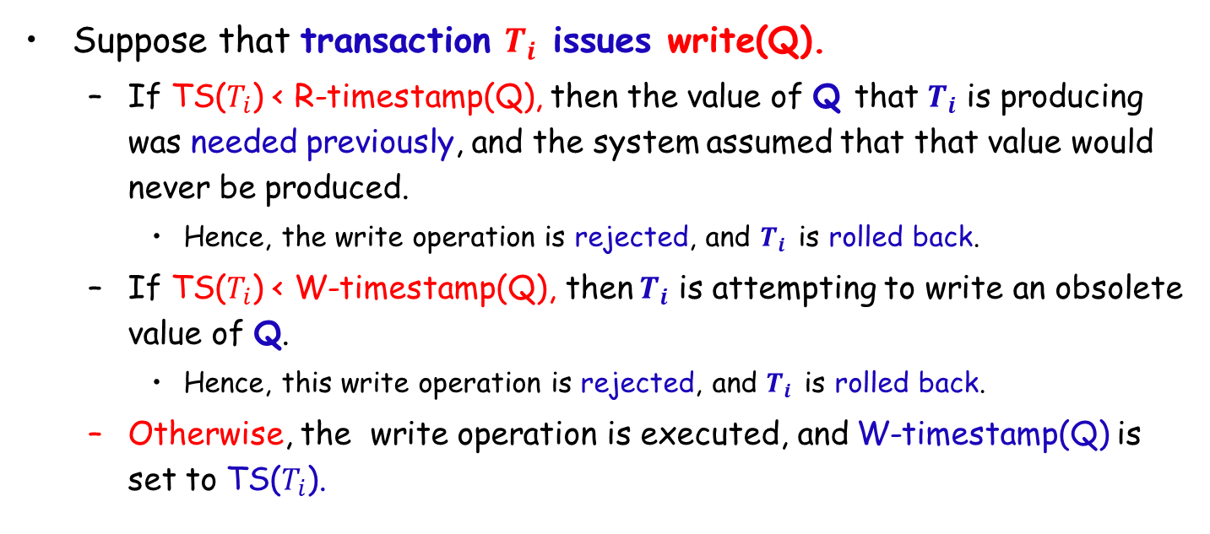
Timestamp-based Protocols (Cont.)
Suppose that transaction $T_{i}$ issues write(Q).
If TS($T_{i}$) < R-timestamp(Q), then the value of Q that $T_{i}$ is producing was needed previously, and the system assumed that that value would never be produced.
Hence, the write operation is rejected, and $T_{i}$ is rolled back.
If TS($T_{i}$) < W-timestamp(Q), then $T_{i}$ is attempting to write an obsolete value of Q.
Hence, this write operation is rejected, and $T_{i}$ is rolled back.
Otherwise, the write operation is executed, and W-timestamp(Q) is set to TS($T_{i}$).

Slide 34
Timestamp-based Protocols (Cont.)
The timestamp-ordering protocol guarantees serializability since all the arcs in the precedence graph are of the form:
Thus, there will be no cycles in the precedence graph
Timestamp protocol ensures freedom from deadlock as no transaction ever waits
But the schedule may not be cascade-free, and may not even be recoverable
transaction
with smaller
timestamp
transaction
with larger
timestamp

Slide 35
Outline
Concurrent Control
Lock-based Protocols
Graph-based Protocols
☞ Multiple Granularity
Deadlock Handling

Slide 36
Multiple Granularity
Allow data items to be of various sizes and define a hierarchy of data granularities
Can be represented graphically as a tree
When a transaction locks a node in the tree explicitly, it implicitly locks all the node's descendants in the same mode
Granularity of locking:
fine granularity (lower in tree): high concurrency, high locking overhead
coarse granularity (higher in tree): low locking overhead, low concurrency

Slide 37
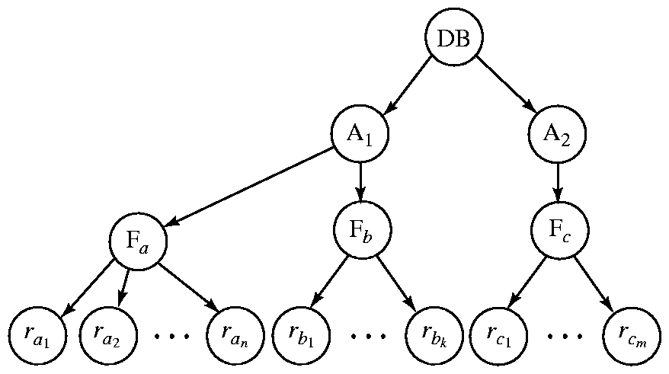
Example of Granularity Hierarchy
The highest level in the example hierarchy is the entire database.
The levels below are of type area, file and record in that order.

Slide 38
Intention Lock (意向锁) Modes
Three additional lock modes with multiple granularity:
intention-shared (IS)
indicates explicit locking at a lower level of the tree but only with shared locks
intention-exclusive (IX)
indicates explicit locking at a lower level with exclusive or shared locks
shared and intention-exclusive (SIX)
the subtree rooted by that node is locked explicitly in shared mode and explicit locking is being done at a lower level with exclusive-mode locks
Intention locks allow a higher level node to be locked in S or X mode without having to check all descendent nodes.

Slide 39
Compatibility Matrix with Intention Lock Modes
IS
IX
S
SIX
X
IS
✓
✓
✓
✓
×
IX
✓
✓
×
×
×
S
✓
×
✓
×
×
SIX
✓
×
×
×
×
X
×
×
×
×
×

Slide 40
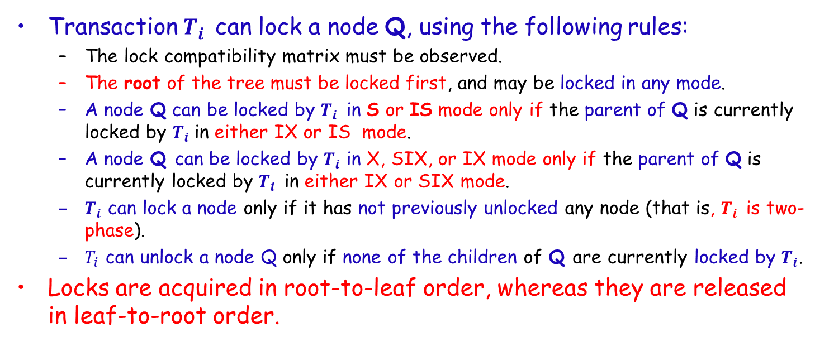
Multiple Granularity Locking Scheme
Transaction $T_{i}$ can lock a node Q, using the following rules:
The lock compatibility matrix must be observed.
The root of the tree must be locked first, and may be locked in any mode.
A node Q can be locked by $T_{i}$ in S or IS mode only if the parent of Q is currently locked by $T_{i}$in either IX or IS mode.
A node Q can be locked by $T_{i}$ in X, SIX, or IX mode only if the parent of Q is currently locked by $T_{i}$ in either IX or SIX mode.
$T_{i}$ can lock a node only if it has not previously unlocked any node (that is, $T_{i}$ is two-phase).
$T_{i}$ can unlock a node Q only if none of the children of Q are currently locked by $T_{i}$.
Locks are acquired in root-to-leaf order, whereas they are released in leaf-to-root order.

Slide 41
Outline
Concurrent Control
Lock-based Protocols
Graph-based Protocols
Multiple Granularity
☞ Deadlock Handling

Slide 42
Deadlock Handling
Consider the following two transactions:
T₁: write(X) T₂: write(Y)
write(Y) write(X)
Schedule with deadlock
T₁
T₂
lock-X on X
write (X)
lock-X on Y
write (Y)
wait for lock-X on X
wait for lock-X on Y

Slide 43
Deadlock Handling
System is deadlocked if there is a set of transactions such that every transaction in the set is waiting for another transaction in the set
Deadlock prevention protocols ensure that the system will never enter into a deadlock state.
Require that each transaction locks all its data items before it begins execution (pre-declaration).
Impose partial ordering of all data items and require that a transaction can lock data items only in the order specified by the partial order (graph-based protocol).

Slide 44
More Deadlock Prevention Strategies
Following schemes use transaction timestamps for the sake of deadlock prevention
wait-die scheme — non-preemptive(非抢占)
older transactions wait for younger ones to release data items, younger transactions never wait for older ones and roll back instead.
one transaction may die several times before acquiring the needed data item
wound-wait scheme — preemptive(抢占)
older transactions would force the rollback of younger transactions instead of waiting for them, younger transactions may wait for older ones.
may be fewer rollbacks than wait-die scheme

Slide 45
Deadlock Prevention (Cont.)
Both in wait-die and in wound-wait schemes
a rolled back transactions is restarted with its original timestamp
older transactions thus have precedence over newer ones, and starvation is hence avoided
Timeout-based schemes (基于超时的机制)
a transaction waits for a lock for a specified amount of time. After that, the transaction is rolled back
thus deadlocks are not possible
simple to implement but starvation is possible. Also difficult to determine the good value of the timeout interval.

Slide 46
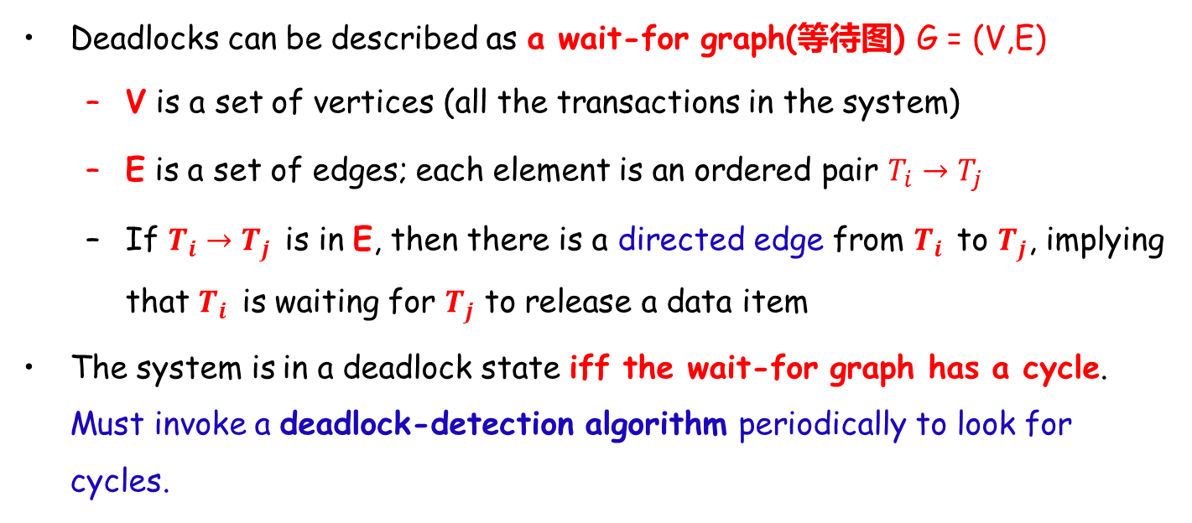
Deadlock Detection
Deadlocks can be described as a wait-for graph(等待图) G = (V,E)
V is a set of vertices (all the transactions in the system)
E is a set of edges; each element is an ordered pair $T_{i}→T_{j}$
If $T_{i}→T_{j}$ is in E, then there is a directed edge from $T_{i}$ to $T_{j}$, implying that $T_{i}$ is waiting for $T_{j}$ to release a data item
The system is in a deadlock state iff the wait-for graph has a cycle. Must invoke a deadlock-detection algorithm periodically to look for cycles.

Slide 47
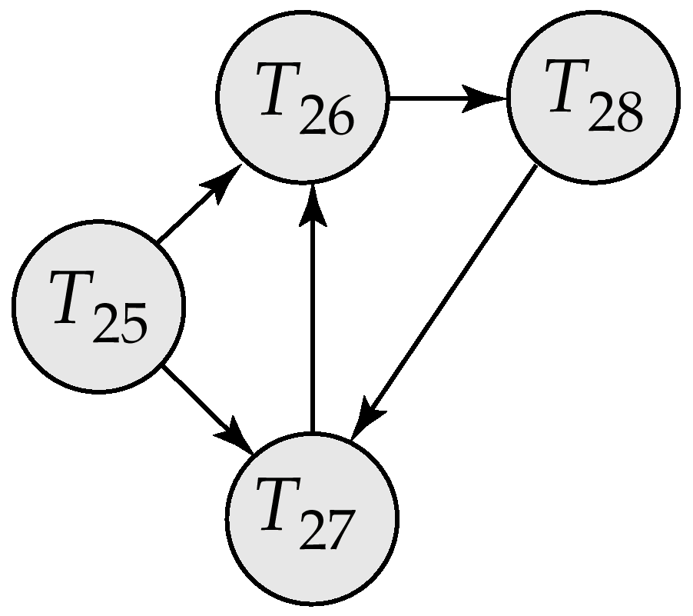
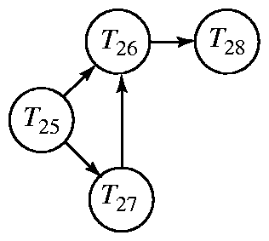
Deadlock Detection (Cont.)
Wait-for graph without a cycle
Wait-for graph with a cycle

Slide 48
Deadlock Recovery
When deadlock is detected
Some transaction needs to roll back
Rollback -- determine how far to roll back the transaction
Total rollback: abort the transaction and then restart it
Partial rollback: more effective to roll back transaction only as far as necessary to break the deadlock
Starvation happens if same transaction is always chosen as victim
Include the number of rollbacks in the cost factor to avoid starvation

Slide 49
End of Lecture 18

